Slide 1
A Whistleblowing Overview
Dr Kim Sawyer
University of Melbourne

Slide 2
Outline
Whistleblowing
Whistleblowing Advocacy
Regulation
Legislation
Conclusion

Slide 3
Whistleblowing
Disclosure by a person, usually an employee in a government agency or private enterprise, to the public or to those in authority, of mismanagement, corruption, illegality, or other wrongdoing.
Why whistleblowing?
Conflict of public versus private interest
A problem of culture
The whistleblowing problem
Every case different

Slide 4
The Rise of Whistleblowing
Defining moments of history
1972: Nader et al (1972)
Main factors last 50 years
  Monetary values/other values
  Institutional change/private-public
  Complexity
  Bystanders/risk aversion
  Networks
Anti-corruption

Slide 5
Conflict of Interest
Public interest: Ex-ante welfare of the representative individual. (Ho (2012)).
The public interest for a journalist is not the same as the public interest for a regulator. The public interest for a regulator not the same as for a politician.
Whistle blower blows the whistle to protect a public interest that is often too diffuse to be protected.

Slide 6
Culture
Australia
  Mateship.
  No compensation for whistle blowers.
  No legal framework for whistle blowers.
  No uniformity across jurisdictions.
The Age, August 28
America pays millions to whistle blower at BHP. We hound them out of their jobs.
http://www.theage.com.au/business/americans-pay-millions-to-whistleblower-at-bhp-we-hound-them-out-of-their-jobs-20160824-gr0b6a.html

Slide 7
The Whistleblowing Event
Pre-
whistleblowing
0
Post-
whistleblowing
Pre-whistleblowing
Wrongdoing
Observation
Bullying
Post-whistleblowing
Discrimination
Bullying
Respondent gap

Slide 8
The Respondent Gap
The players
  Whistleblower(s)
  Respondent(s)
  Bystander(s)
  Regulator(s) (internal and external)
Net present value gap
Respondent
Whistle blower

Slide 9
Every Case Different
Conservative or non-conservative
Private sector or public sector
Senior or non-senior employee
Length of pre-whistleblowing period
Materiality of information
Number of whistle blowers/bystanders
Type of retribution

Slide 10
Advocacy
Academic
  PhD at ANU 1980
  Taught 5 years in Australian universities and 5 years in US universities
  Appointment at new university
Universities in transition: greater public-private interest conflicts.
Established one of first Masters market oriented programs
Whistleblowing case began in 1992

Slide 11
Advocacy
Case 1 (RMIT)
Case 2 (Melbourne University)
Test of Whistleblowing
Advocacy
  WBA
  National Conferences
  Advocate for cases
  Articles newspapers/journals
  Parliamentary inquiries

Slide 12
Case 1 (1992-1996)
Professor at RMIT
16 academics raised concerns
12 left within two years
Three years in Supreme Court
  Confidential settlement
  Letter of reference
Changes in procedures
Changes to rights of appeal of staff

Slide 13
Case 2 (1998-2002)
Head of Discipline
Sought advice and then inquiry
Legal opinion
Newspapers
Changes in procedures
Parliamentary inquiry

Slide 14
The Test Called Whistleblowing
Test of values
  Fairness, truth, natural justice.
Test of loyalties
  Employer, colleagues, friends,
Test of justice
  Legal system
Test of inversion
  Legal justice versus natural justice
Test of self-worth

Slide 15
Advocacy
“The exercise of whistleblowing is really akin to removing a cancer, typically a cancer that is growing in a public institution. The cancer depends for its existence on a number of pre-conditions, typically a highly discretionary environment (both in terms of financial and managerial accountability), weakness in the host institution (that is, the weakness of members of the institution), and finally that the cancer is sufficiently embedded, that is, it exists at the very core of the institution. The whistle blower identifies the cancer, attempts to remove it, and then is attacked by it. The attack usually takes the form of harassment of varying degrees of intensity. The whistle blower is characterized variously as a troublemaker, a zealot, a crusader, a pursuer of trivia, and those are the most acceptable designations. There are many observers of the harassment, but virtually no preventers. The whistle blower must at all times behave honourably; the cancer can behave as it likes, it has all the power. The whistle blower, however, must be ethical, rational and not excessive. Unsurprisingly, whistleblowing is not usually successful.”

Slide 16
Advocacy
Whistleblowers network
Whistle blowers Australia
  First national meeting 1993
  Chairperson Victoria for 5 years
  Organized a number of national conferences
  The Whistle
1996 National Conference
  100 attendees
  NSW, Vic Police
  NCA
  Universities, Hospitals, Banking, SRA
  Radio interview

Slide 17
Advocacy
Cases
NCA
Police
Government agencies
Universities
Defence
Health

Slide 18
Advocacy
General
1994 Senate inquiry
  39 recommendations
  Public Interest Disclosure Agency
  Public Interest Disclosure Board
  Tort of victimisation
  No False Claims Act (FCA)
1995-6
  Advocate for FCA
  Economic and moral imperative
1994
  Bill of Rights
  Bystander (accomplice) problem

Slide 19
Advocacy
Parliament
Appeared before five inquiries.
Submissions to five others.
Most recent to the establishment of a National Integrity Commission
2014 whistleblowing legislation enabled.
600 disclosures in first year.
FCA is still to be enacted.

Slide 20
Advocacy
Wikileaks
2007
Whistleblowing Exchange
  Detailed information deposited
  Anonymity and source protection
  Access to all
Melbourne University
Support of whistle blowers
Leaking versus whistleblowing

Slide 21
Papers
SSRN, Researchgate
Courage Without Mateship
The Test Called Whistleblowing
The Necessary Illegitimacy of the Whistle blower
Lincoln’s Law: An Analysis of an Australian False Claims Act
The Partnership Called Whistleblowing
The Invisible Hand: When the Firm Becomes the Bully
The Independent Regulator
The Psychology of Whistleblowing

Slide 22
Regulation
The regulatory spectrum
Mandated regulators
  Risk averse
  Minimize risk of institutions
  Confidentiality
Independent regulators
  Retaliation, litigation, reputation risk
  Transparency
Self-regulation
Mandated
Regulators
Independent
Regulators

Slide 23
Regulation
To regulate is to observe, to arbitrate and to equilibrate by reference to the laws, rules and codes established by precedent.
Regulation continuously changes with the ebb and flow of decisions.
A regulator must be sufficiently independent so as to regulate, yet sufficiently accountable to regulate fairly.
Regulation is vitiated by four problems
(1) Not all behaviour can be prescribed.
(2) Not all behaviour can be observed.
Not all behaviour admits to incentives and disincentives.
Not all behaviour can be measured.

Slide 24
Regulation
Transactions cost or corruption?
Contractor A is tendering for a government contract determined by bureaucrat B. A successfully bids for the contract by providing an inducement to B sufficient to ensure B awards the contract to A, but is unobservable to a regulator.
A considers the following inducements to B
Cash payment to B.
Gifts to B.
Hospitality to B.
Donation to a charity of B’s choice.
Future job for B with A’s firm.
Future job for relative or friend of B.
Future equity for B in A’s firm.
Networking with B based on an attribute unrelated to the contract.

Slide 25
Regulation
The Lessons of Whistleblowing
Observability
Certainty
Uncertainty
Simplicity
Public Interest
Anticipatory
Implicit Contracts
Primary Nodes
Culture
Transparency
Incentives and Disincentives

Slide 26
The Independent Regulator
Whistleblowing moves regulation away from the mandated and fixed regulation of the past. To regulation which is simpler, more certain and more observable; where we are all regulators but not of others’ legitimate right to privacy; where the public interest is our interest; where we extract from the public endowment as we want others to extract from that endowment. Whistleblowing is the first step on an iterative path towards an era of independent regulation.

Slide 27
Whistleblowing Legislation
Disclosure
Freedom of speech
Discrimination

Slide 28
Disclosures
Whistleblowing Principles
Vaughin, Devine and Henderson
Focus on the information disclosed, not the whistle blower.
Relate law to freedom of expression laws.
Permit disclosure to different agencies in different forms.
Include compensation or incentives for disclosure.
Protect any disclosure, whether internal or external, whether by citizen or employee.
Involve whistle blowers in the process of the evaluation of their disclosure.
Have standards of disclosure.

Slide 29
False Claims Act
Claim is a request or demand, whether under a contract or otherwise, for money or property which is made to a contractor, where the United States government provides any portion of the money or property requested or demanded.
False claim refers to any knowing falsity associated with the claim; knowing means
Has actual knowledge of the information.
Acts in deliberate ignorance of the truth or falsity of the information.
Acts in reckless disregard of the truth or falsity of the information.
.

Slide 30
False Claims Act
Advantages for whistle blower
Specific protection against discrimination in employment, including restitution to their previous employment status, compensation for discrimination and any litigation costs.
FCA operates under the lowered evidence standard of preponderance of evidence.
Reversal of onus of proof.
When DOJ intervenes, the whistle blowers’ litigations costs are met by the government.
Whistle blower guaranteed share of the recovery of fraud in a successful prosecution.
FCA integrates fraud recovery and whistleblowing.
Cost-benefits of whistleblowing.

Slide 31
US False Claims Act
Cumulative US fraud recovery $48b
Fraud recovery last 10 years $33b
Efficient act: for every $1 spent on investigation, $16 recovered.
http://www.taf.org/DOJ-FCA-Statistics-2015.pdf
Deficit reduction act: public-private partnership

Slide 32
US False Claims Act

Slide 33
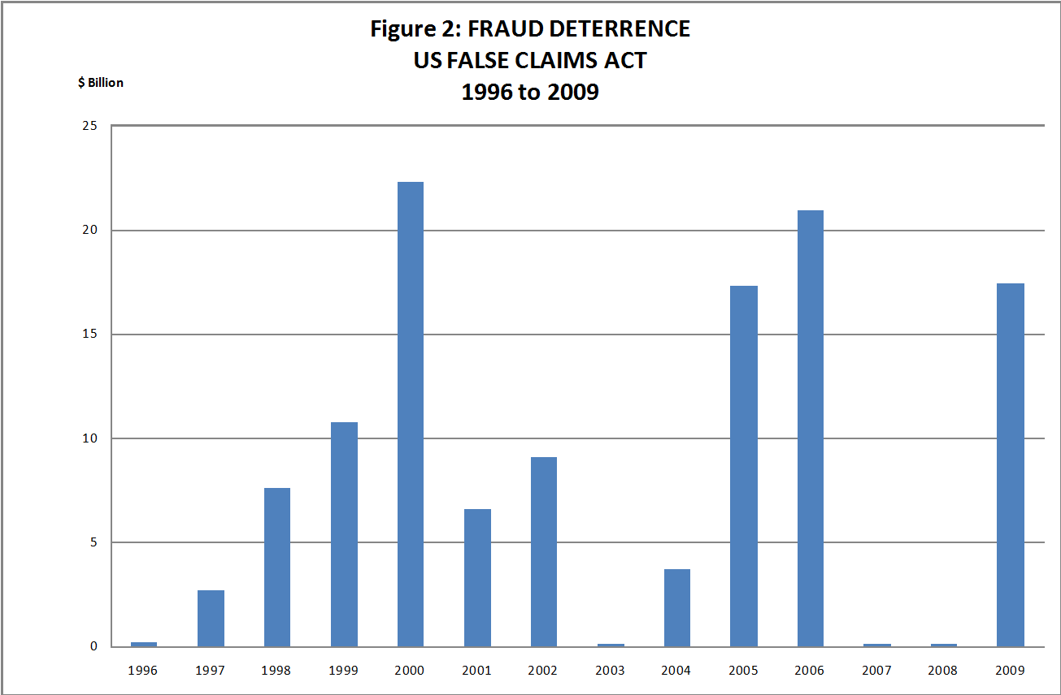
Deterrence of whistleblowing
FCA

Slide 34
Australian False Claims Act
Example
A false claim is any claim on Commonwealth which is knowingly false
(i) knowingly failing to calibrate against a value for money benchmark; or
(ii) knowingly overcharging on costs
(iii) failure to follow contract specifications (iv) failure to exercise due diligence.
Protected disclosures include, but are not limited to
Illegal activity
False claims
Wastage of public funds
Breach of public trust
Risk to health and safety and to the environment
Official misconduct
Retaliation against those making disclosures

Slide 35
Australian False Claims Act
These recommendations are designed to
(1) Focus on the information, not those who inform.
(2) Specify more precisely the terms of contracts with the Commonwealth.
(3) Specify more precisely non-compliance.
(4) Increase the deterrence to non-compliance.

Slide 36
Public Disclosures

Slide 37
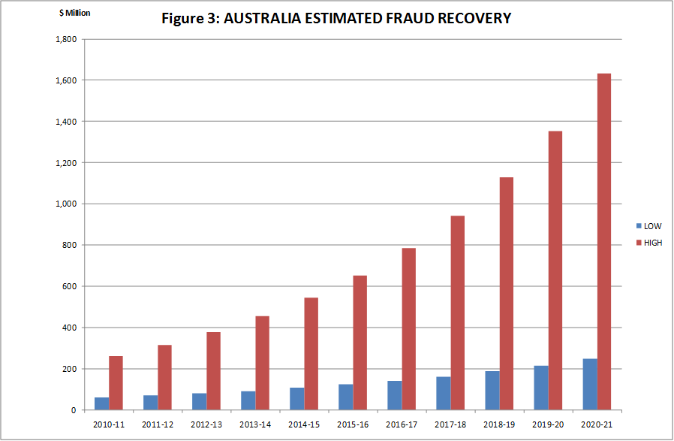
Estimated Australian Fraud Recovery

Slide 38
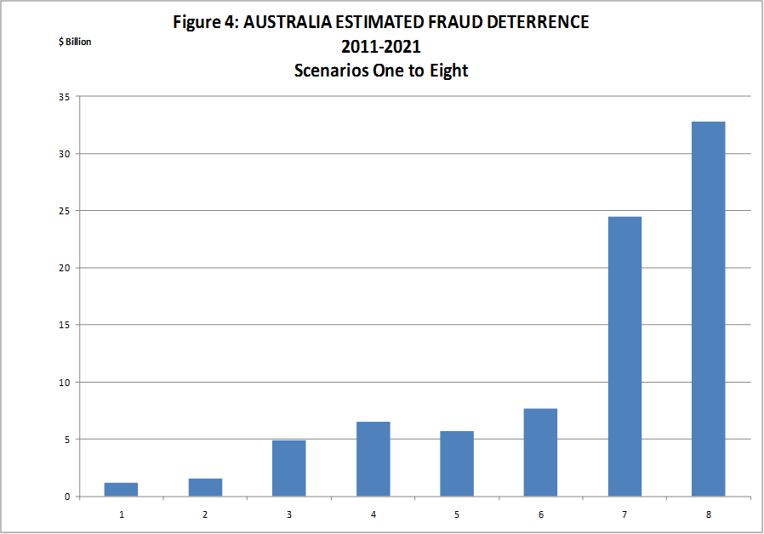
Estimated Fraud Deterrence

Slide 39
Discrimination
Separation of information from informant
Discrimination
  Exclusion
  Precise targeting
  Smearing
  Threats
  Promotion of respondents
Tort of discrimination?
Information
Informant

Slide 40
Discrimination
Penalties for discrimination in 2001, 2014 whistleblowing legislation are penalties in name only. No better protection now than in 1993.
Australia needs a prosecution for retaliation against a whistle blower.
There are non-statutory mechanisms which are simpler and may protect the whistle blower more effectively
  Citations for good corporate conduct.
  Statement from institution.

Slide 41
Conclusion
Whistleblowing
  Both new and old problem
New laws and amendments to old laws
Better employment contract design
Better discrimination provisions
The evolutionary nature of the law

